Slide 1
Negative Binomial Distribution
Prepared by
Sajana Shakya

Slide 2
Negative Binomial Distribution
Conditions:
The experiment consists of X+r repeated trials.
Every trial has two possible outcomes. That is success and failure.
The probability of success p is same on every trial.
The trials are independent.
The experiment continues to produce r successes.

Slide 3
Then the distribution of number of failures before observing r successes is called negative binomial distribution.
For eg: tossing a coin repeatedly until 2 heads produced.
Here, r=2 success->head failure->tail
X-> number of failures required to produce 2 heads total trials -> 2,3,4,……. ∞
X=0,1,2,3…..∞
X->Negative random variate

Slide 4
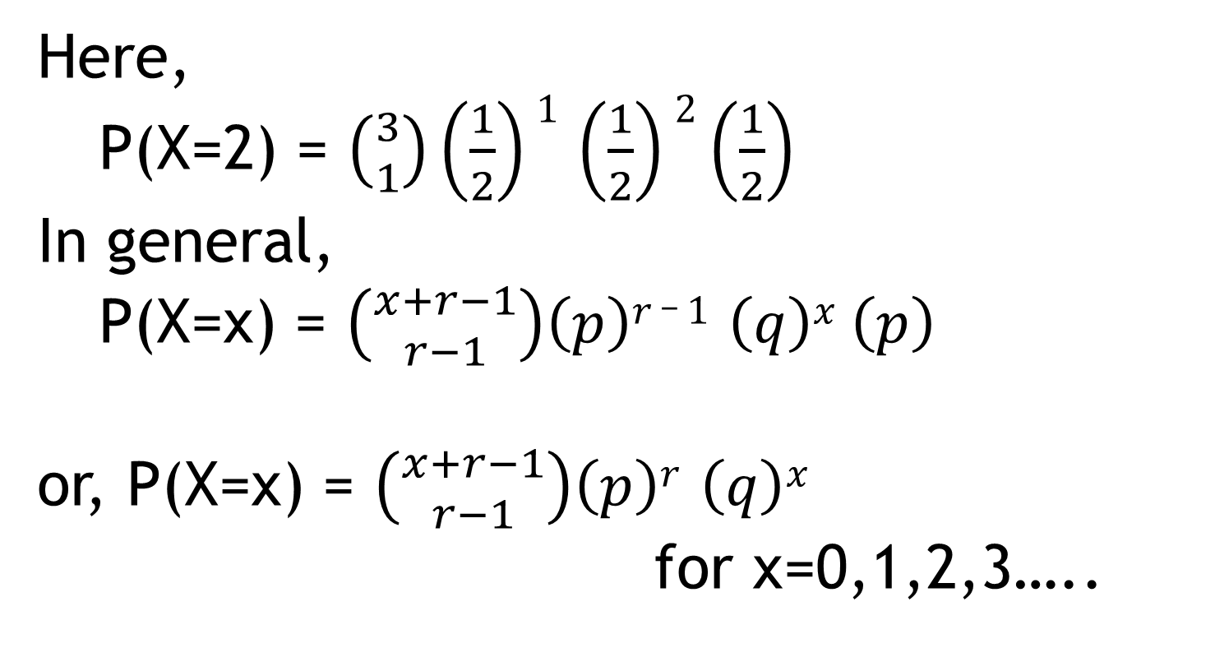
Here,
P(X=2) = $\left({3 \atop 1}\right)\left(\frac{1}{2}\right)1$ $\left(\frac{1}{2}\right)2$ $\left(\frac{1}{2}\right)$
In general,
P(X=x) = $\left({x+r−1 \atop r−1}\right)\left(p\right)r _ 1$ $\left(q\right)x$ $\left(p\right)$ or, P(X=x) = $\left({x+r−1 \atop r−1}\right)\left(p\right)r$ $\left(q\right)x$ for x=0,1,2,3…..

Slide 5
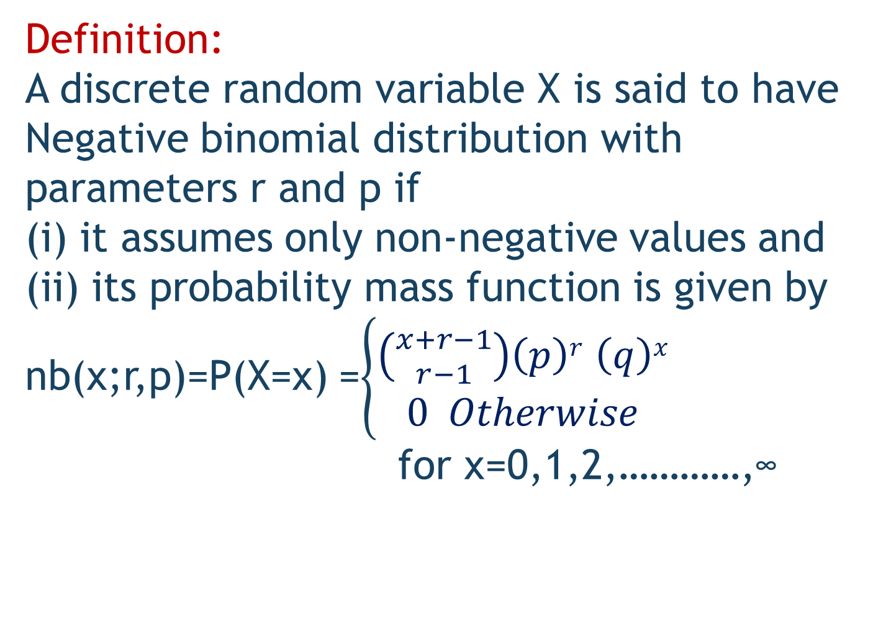
Definition:
A discrete random variable X is said to have Negative binomial distribution with parameters r and p if
(i) it assumes only non-negative values and
(ii) its probability mass function is given by nb(x;r,p)=P(X=x) =$\left\{\begin{aligned}\left({x+r−1 \atop r−1}\right)\left(p\right)r \left(q\right)x \\ 0 Otherwise\end{aligned}\right.$ for x=0,1,2,…………,∞

Slide 6
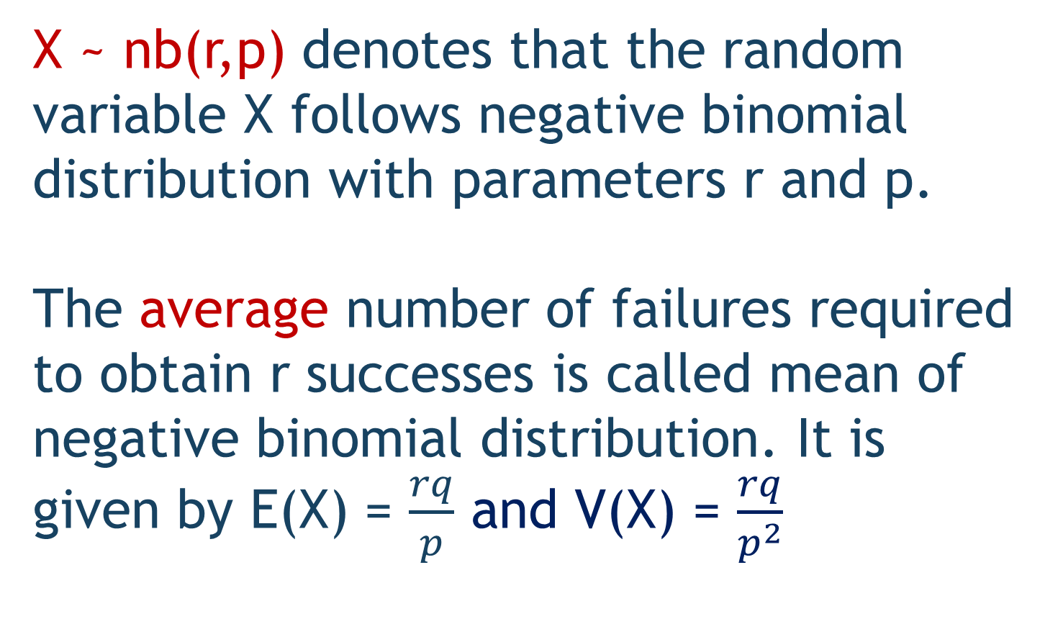
X ~ nb(r,p) denotes that the random variable X follows negative binomial distribution with parameters r and p.
The average number of failures required to obtain r successes is called mean of negative binomial distribution. It is given by E(X) = $\frac{rq}{p}$ and V(X) = $\frac{rq}{p^{2}}$

Slide 7
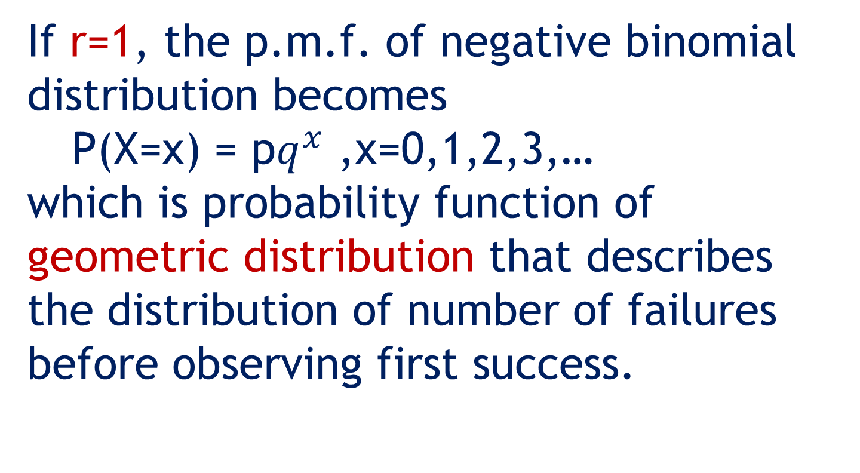
If r=1, the p.m.f. of negative binomial distribution becomes
P(X=x) = p$q^{x}$ ,x=0,1,2,3,… which is probability function of geometric distribution that describes the distribution of number of failures before observing first success.

Slide 8
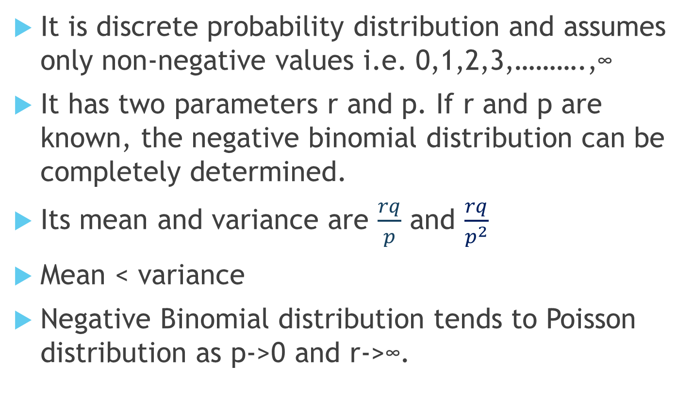
Properties of Negative Binomial Distribution
It is discrete probability distribution and assumes only non-negative values i.e. 0,1,2,3,……….,∞
It has two parameters r and p. If r and p are known, the negative binomial distribution can be completely determined.
Its mean and variance are $\frac{rq}{p}$ and $\frac{rq}{p^{2}}$
Mean < variance
Negative Binomial distribution tends to Poisson distribution as p->0 and r->∞.

Slide 9
Problem 1:
The probability that a person in a society be thief is 0.01. Cop is searching the thieves by taking them at random. What is the probability that 10 persons are to be examined in order to get 3 thieves?

Slide 10
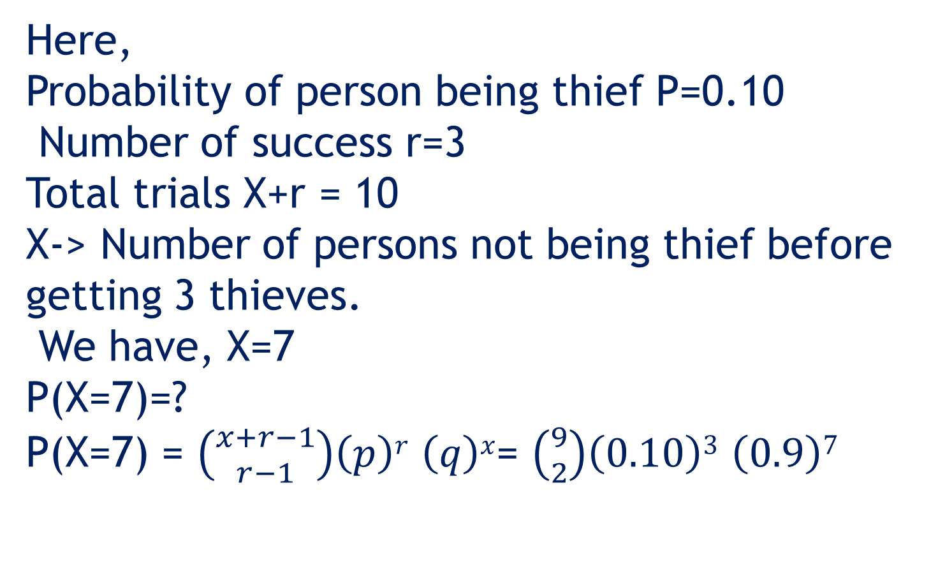
Here,
Probability of person being thief P=0.10
Number of success r=3
Total trials X+r = 10
X-> Number of persons not being thief before getting 3 thieves.
We have, X=7
P(X=7)=?
P(X=7) = $\left({x+r−1 \atop r−1}\right)\left(p\right)r \left(q\right)x$= $\left({9 \atop 2}\right)\left(0.10\right)3 \left(0.9\right)7$

Slide 11
Problem 2:
A well-known baseball player has a lifetime bating of 0.7. What is the probability that 40 or fewer times at bat are required for him to achieve 36 hits?

Slide 12
Problem 3:
An item is produced in large number. The machine is known to produce 5% defectives. A quality control inspector is examining the items by taking them at random. What is the probability that at least 4 items are to be examined in order to get 2 defective?

Slide 13
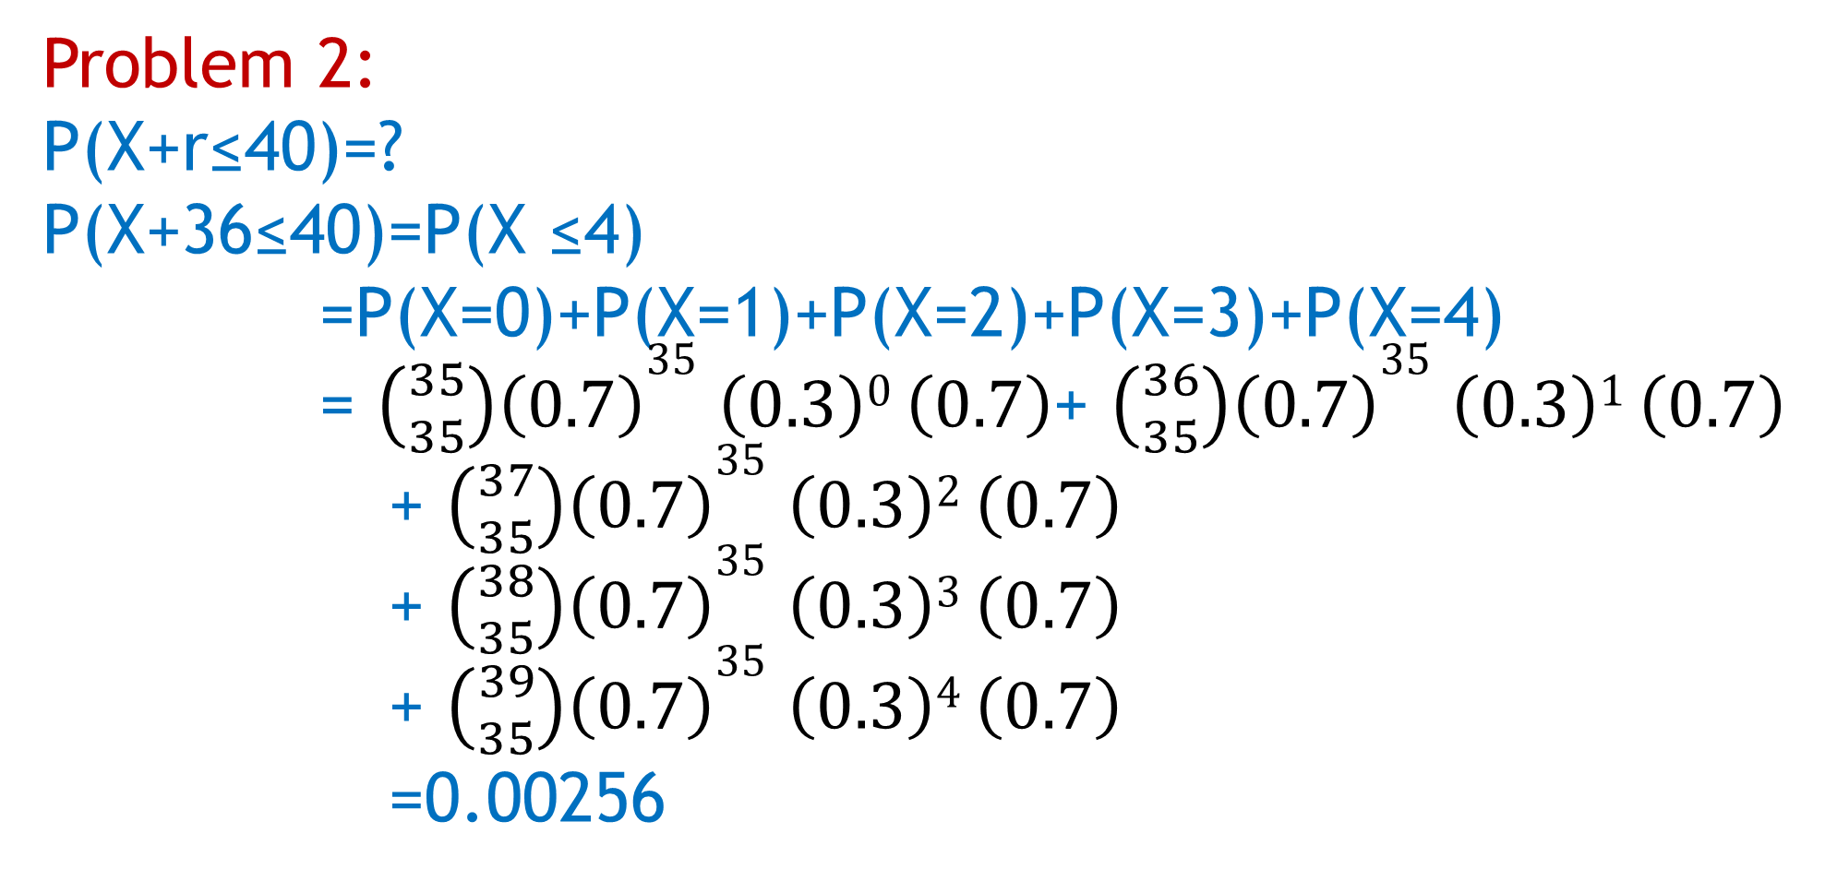
Problem 2:
P(X+r≤40)=?
P(X+36≤40)=P(X ≤4)
=P(X=0)+P(X=1)+P(X=2)+P(X=3)+P(X=4)
= $\left({35 \atop 35}\right)\left(0.7\right)35$ $\left(0.3\right)0$ $\left(0.7\right)$+ $\left({36 \atop 35}\right)\left(0.7\right)35$ $\left(0.3\right)1$ $\left(0.7\right)$
+ $\left({37 \atop 35}\right)\left(0.7\right)35$ $\left(0.3\right)2$ $\left(0.7\right)$
+ $\left({38 \atop 35}\right)\left(0.7\right)35$ $\left(0.3\right)3$ $\left(0.7\right)$
+ $\left({39 \atop 35}\right)\left(0.7\right)35$ $\left(0.3\right)4$ $\left(0.7\right)$
=0.00256

